Slide 1

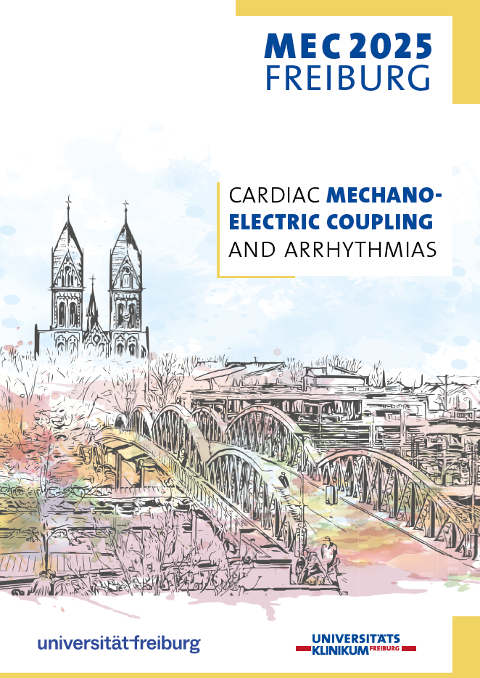

Welcome to the 10th edition of
Cardiac Mechano-Electric Coupling and Arrhythmias
17-20 Sept 2025, Freiburg
Org Com:
Rémi Peyronnet
Alexander Quinn
Ramona Emig
Eilidh MacDonald
Leonardo Sacconi
Point of contact: Julia Verheyen
Notes:
Sofia Monaci

Slide 2
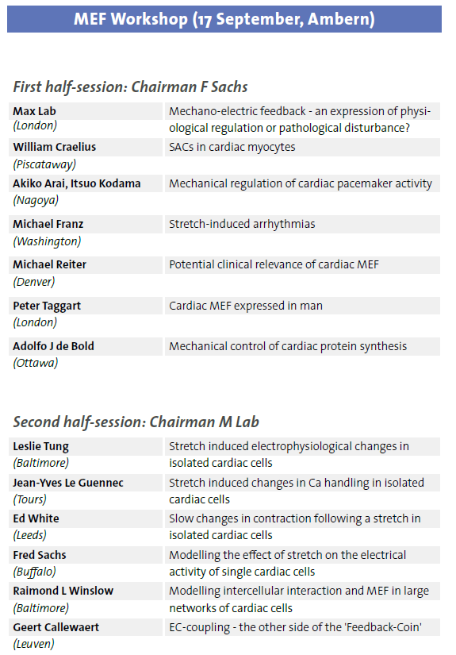
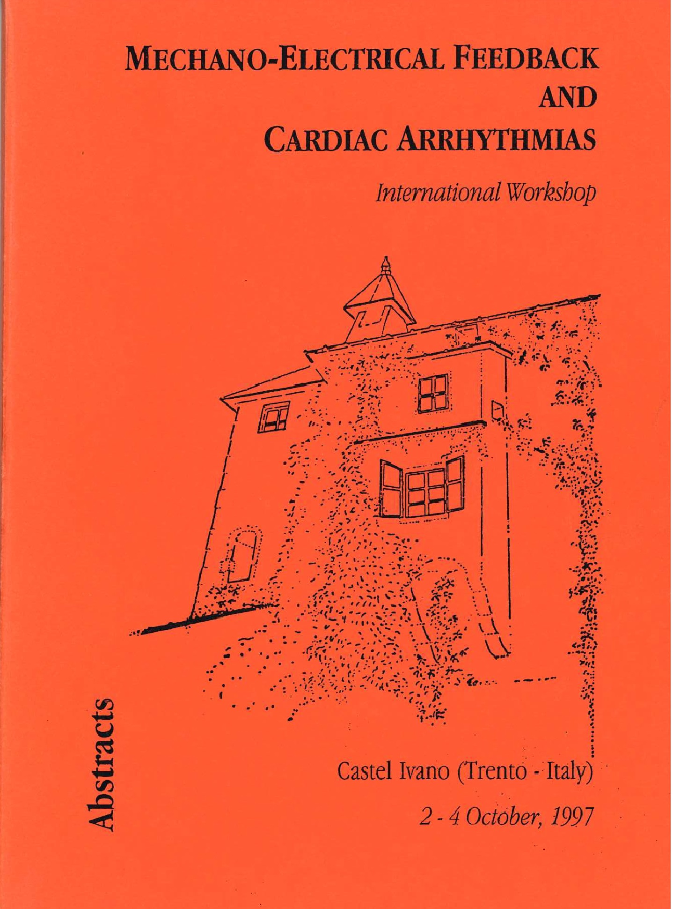
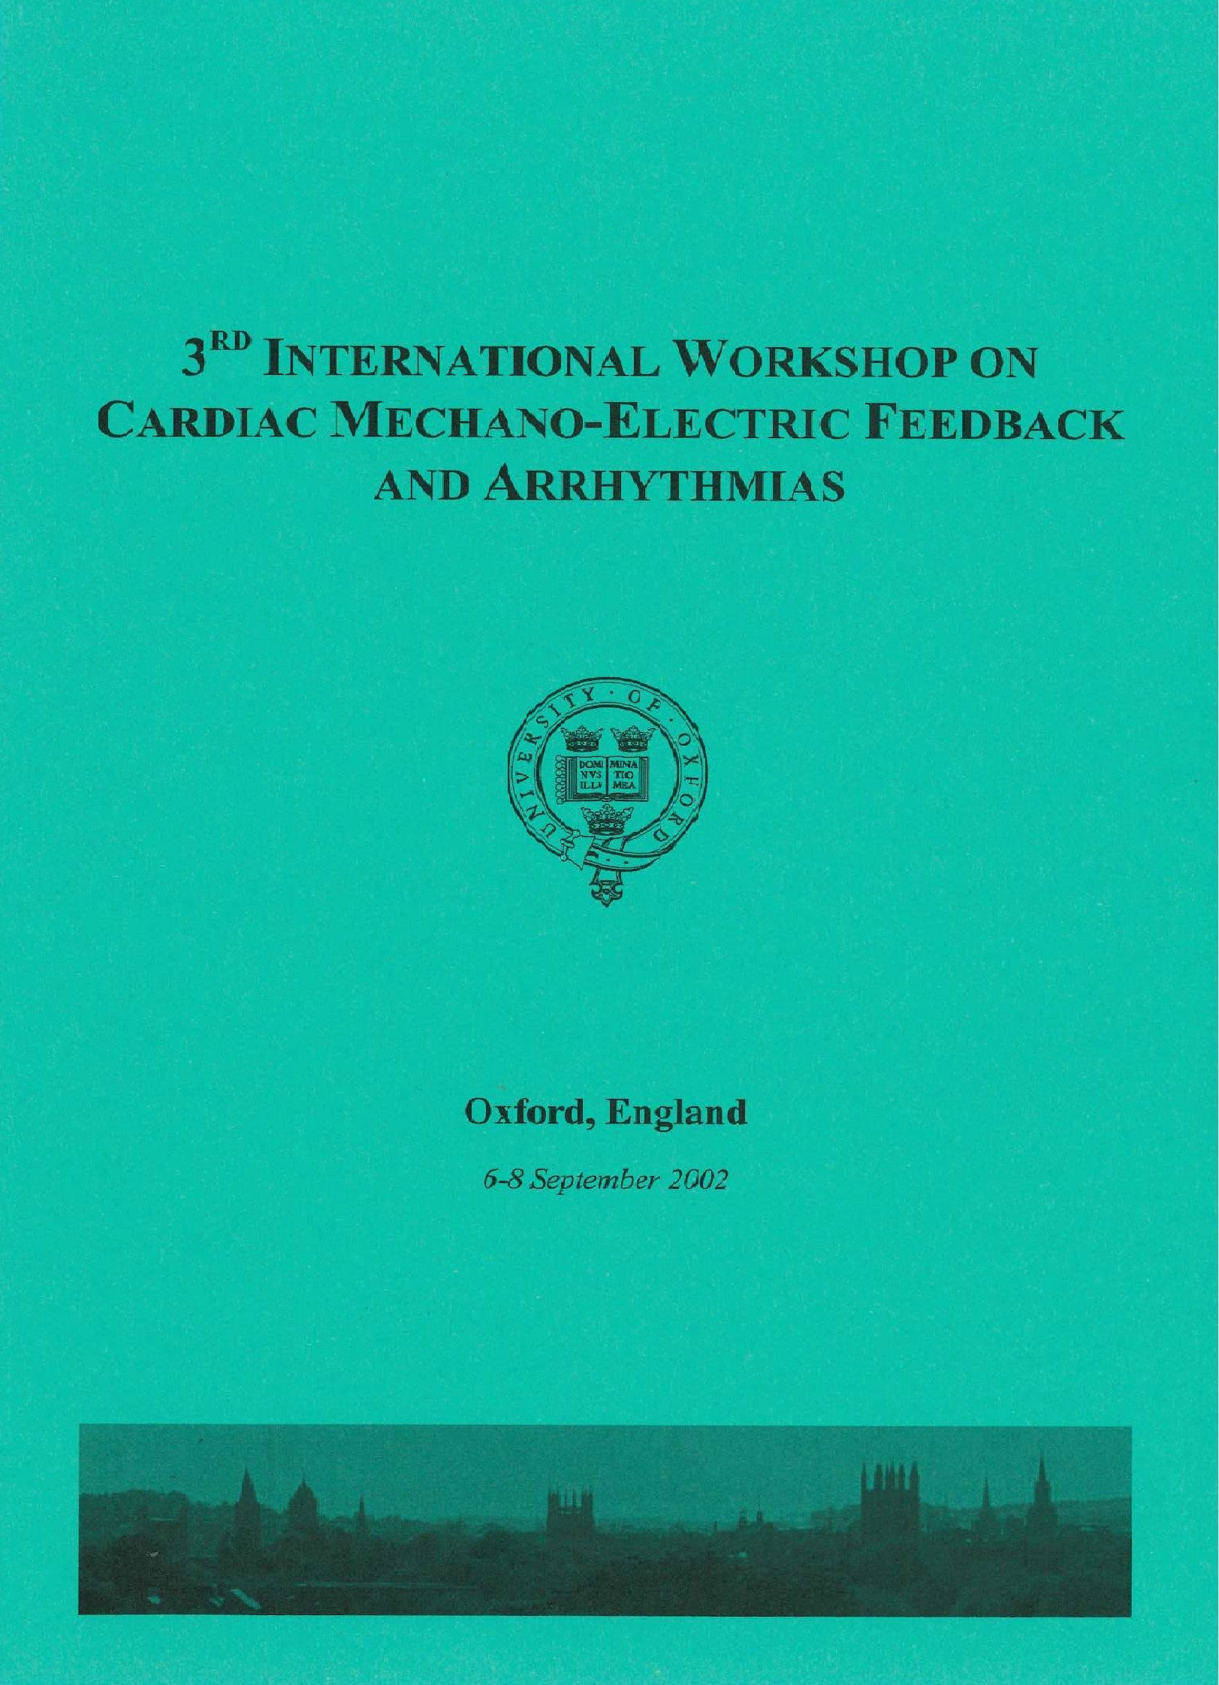
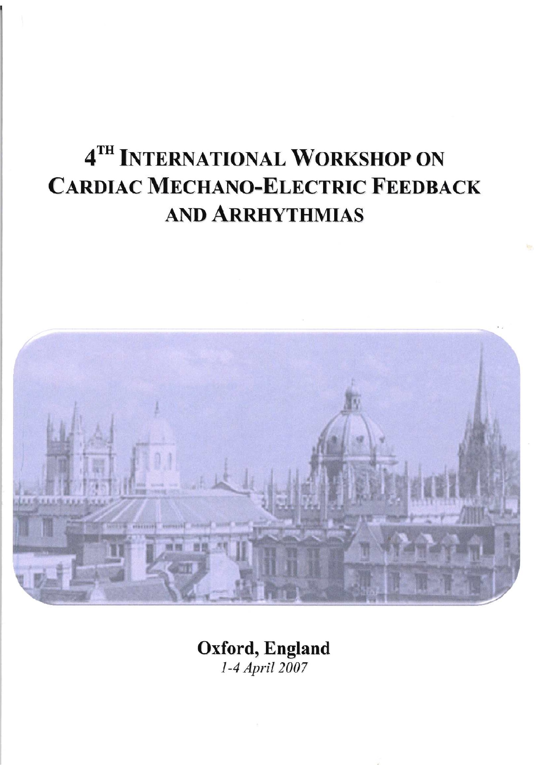
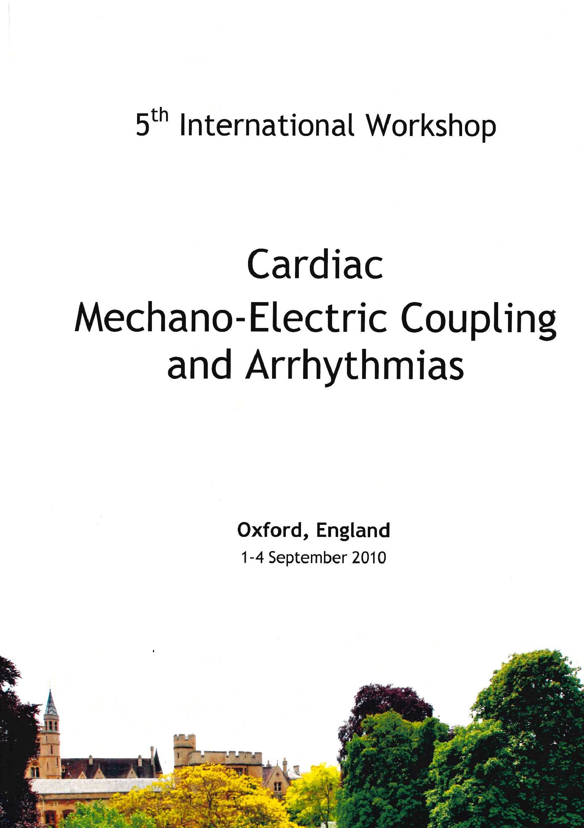
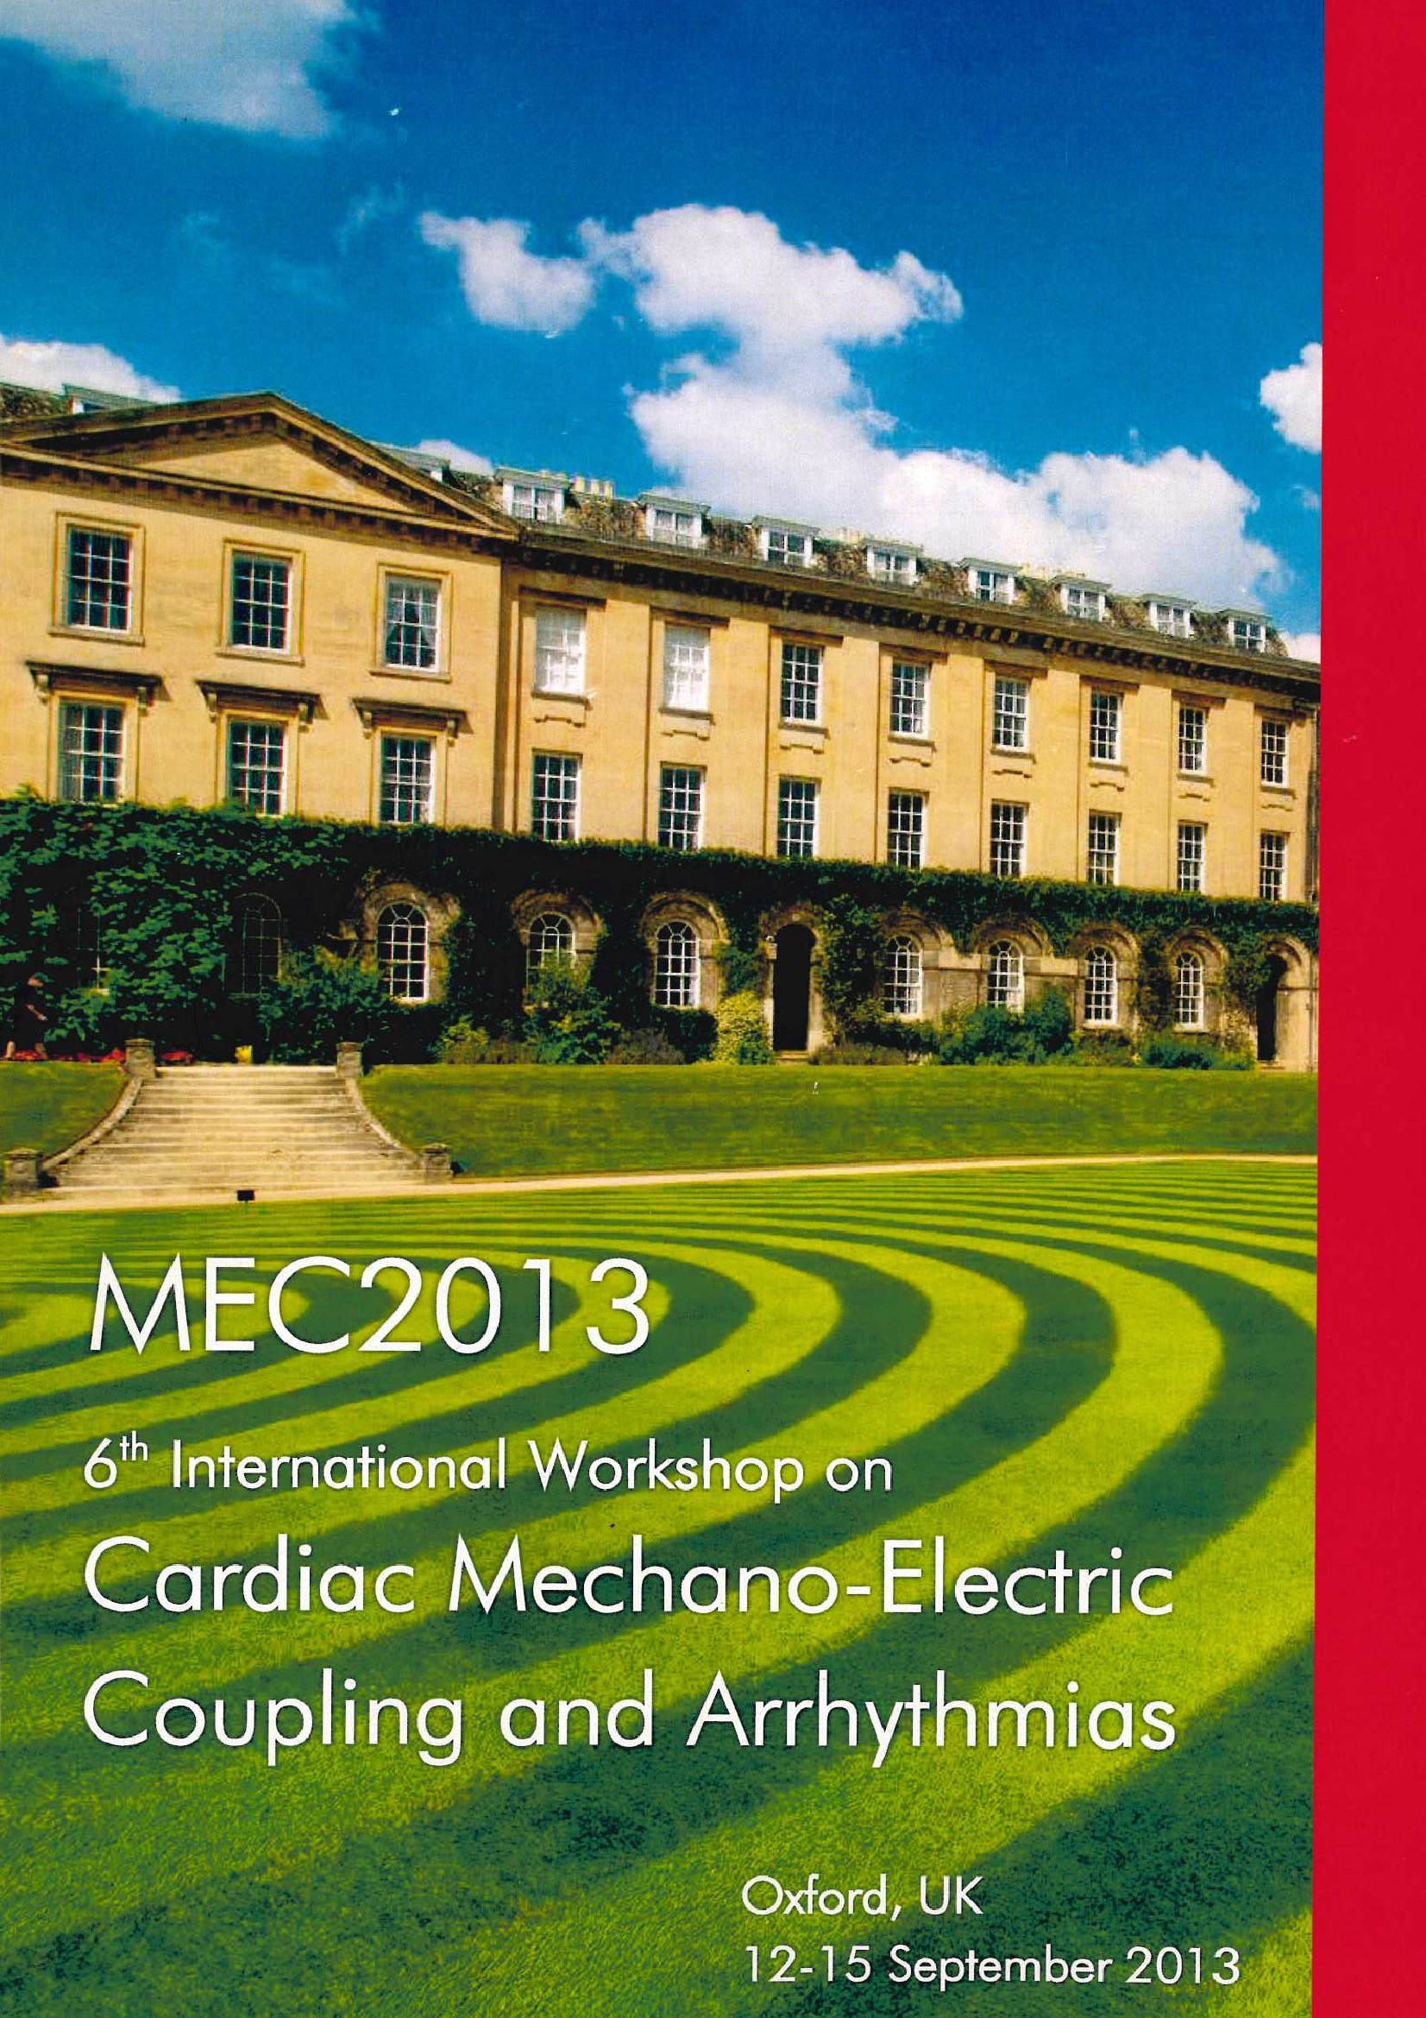
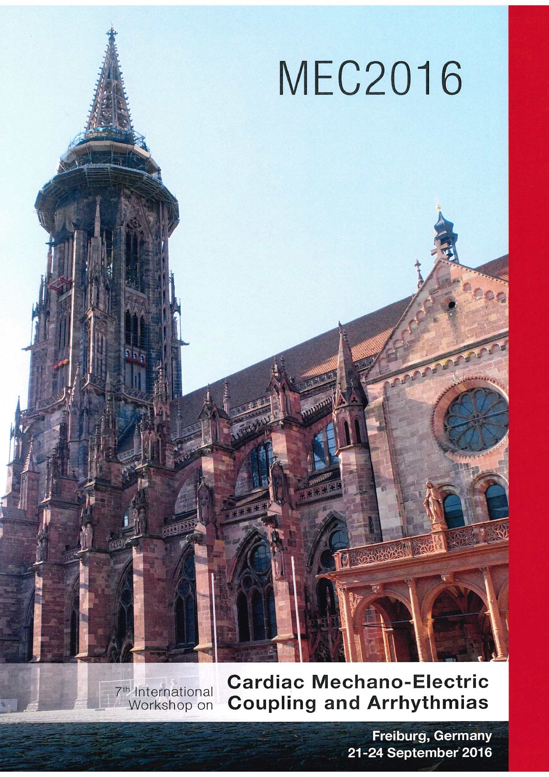
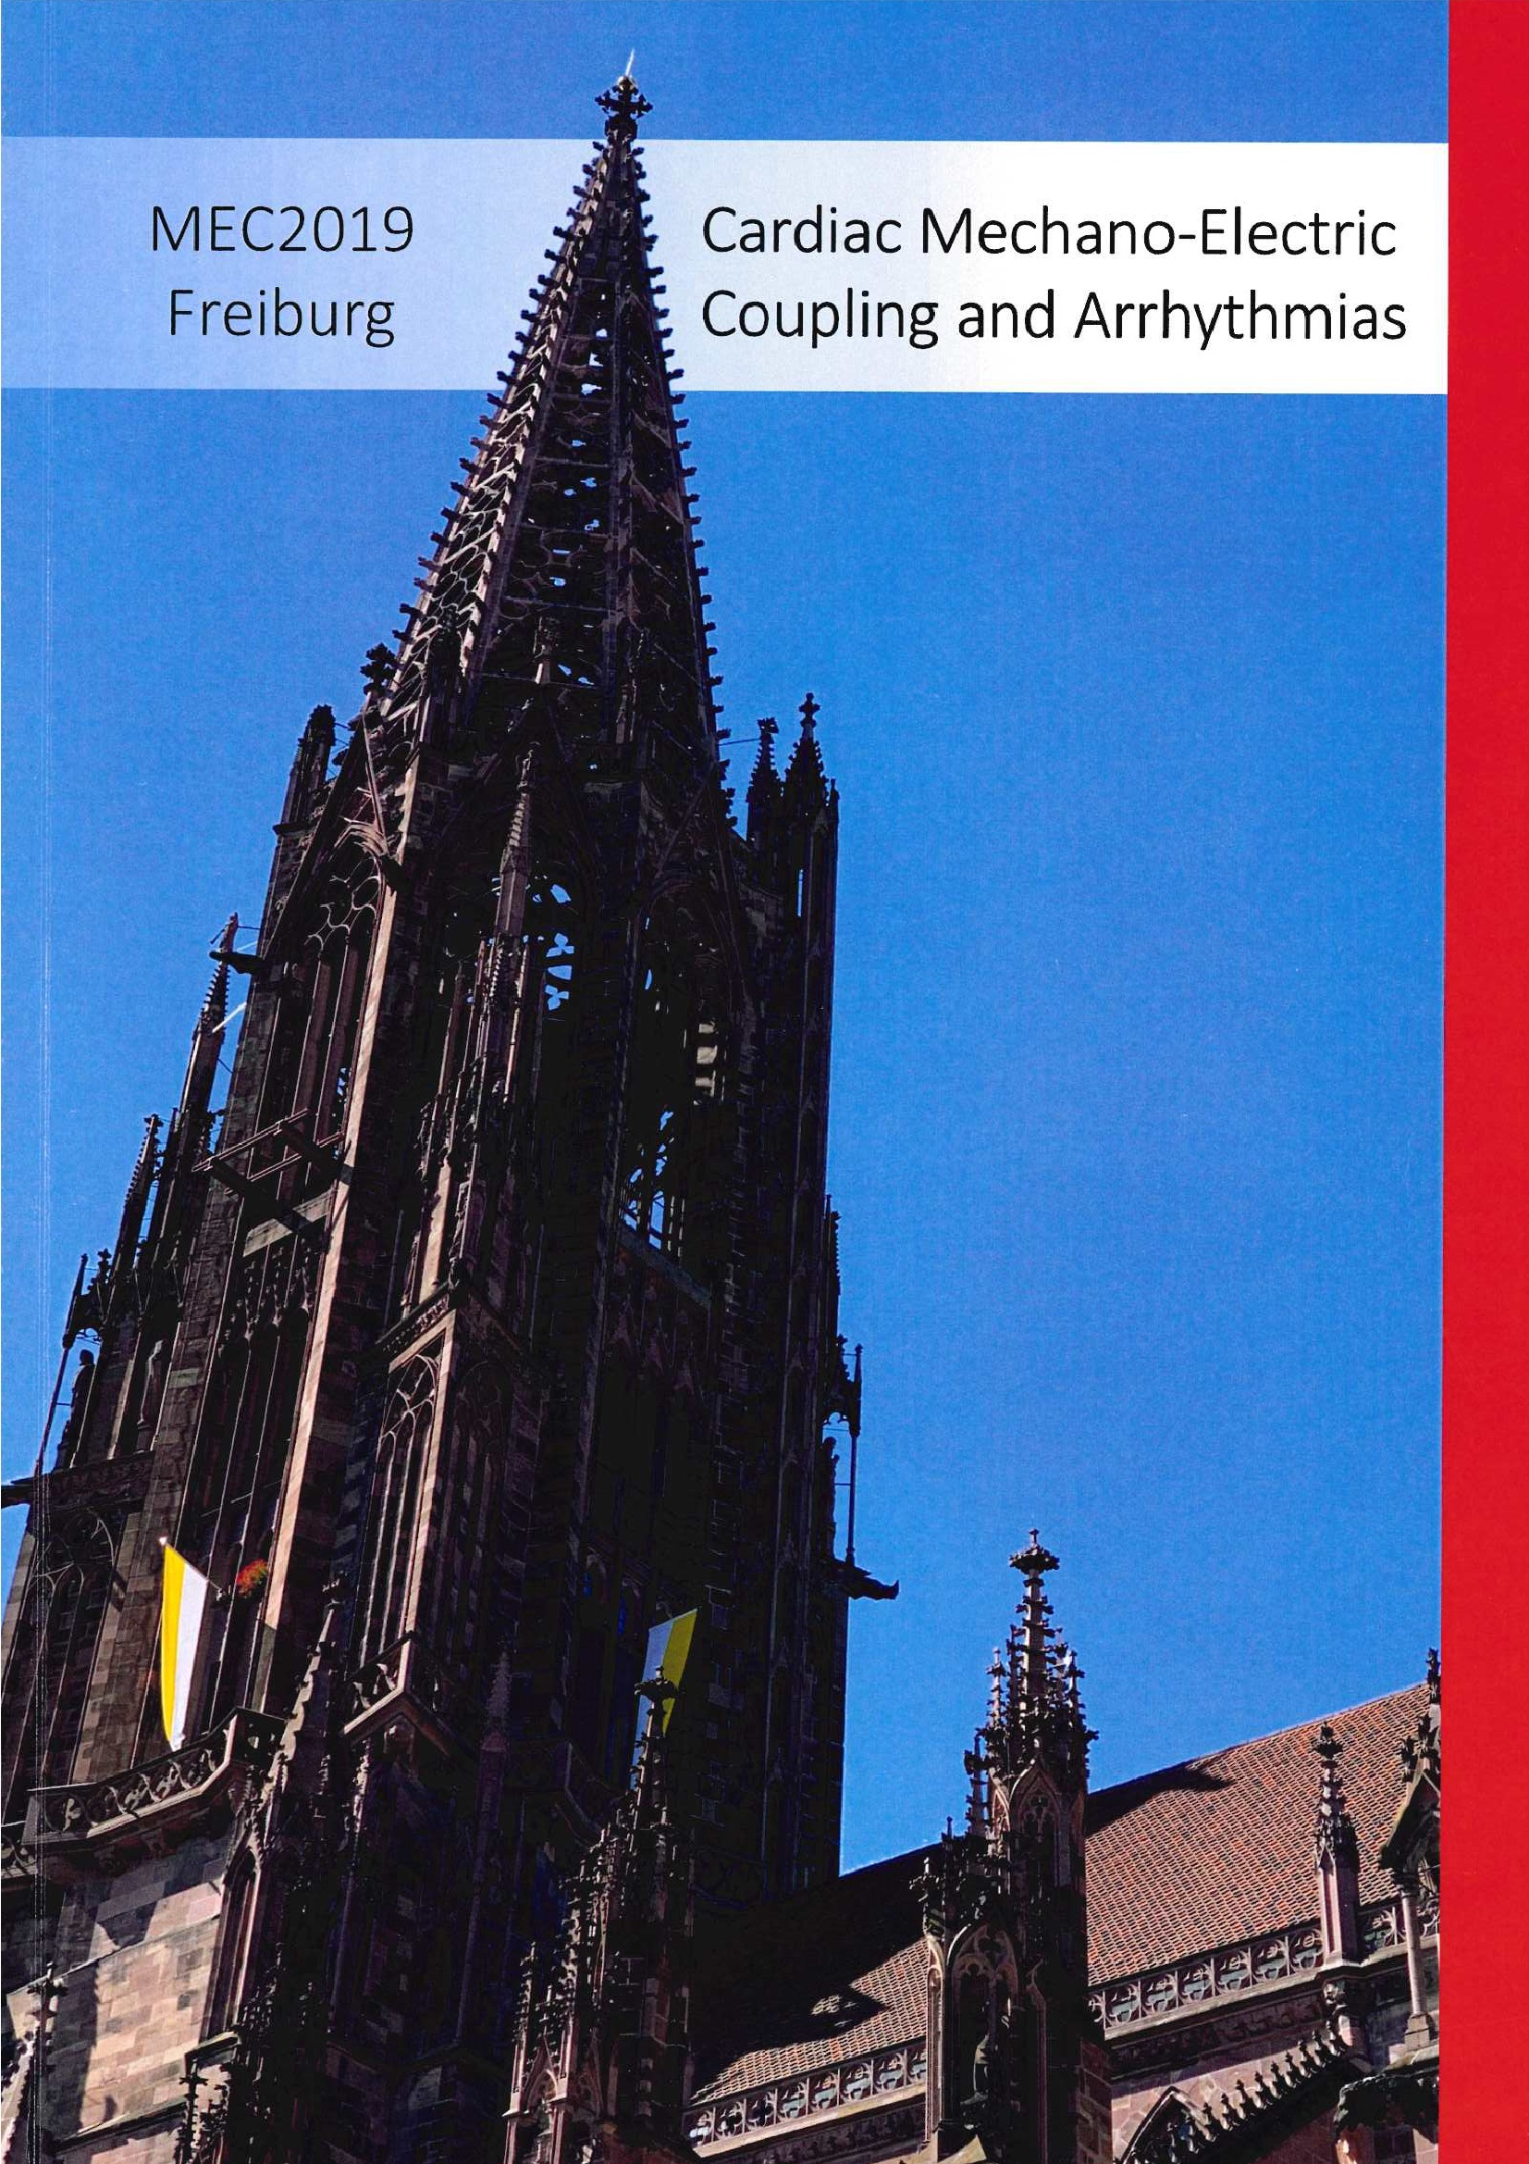
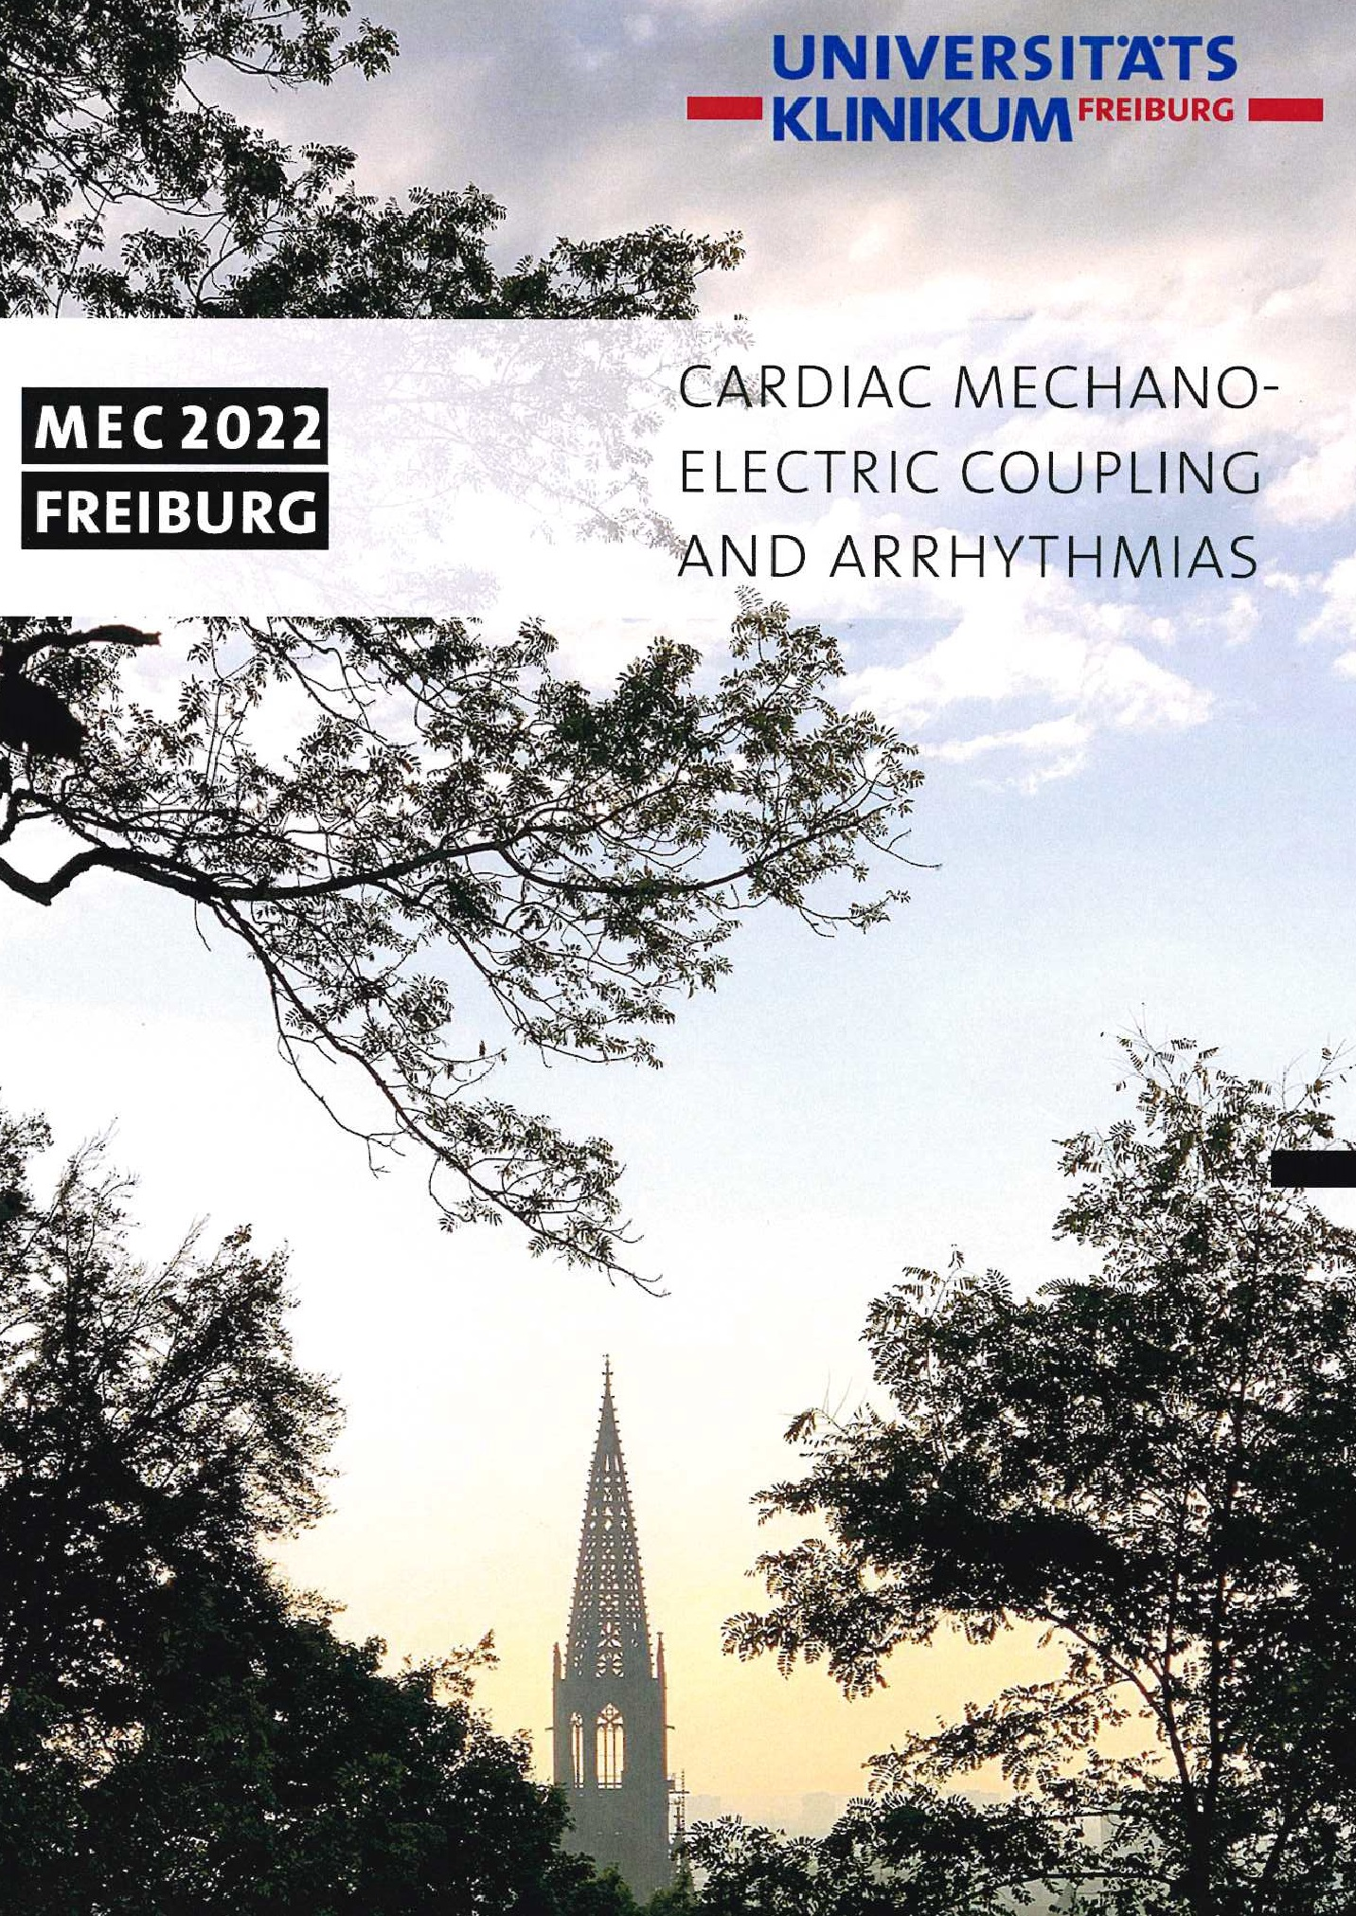
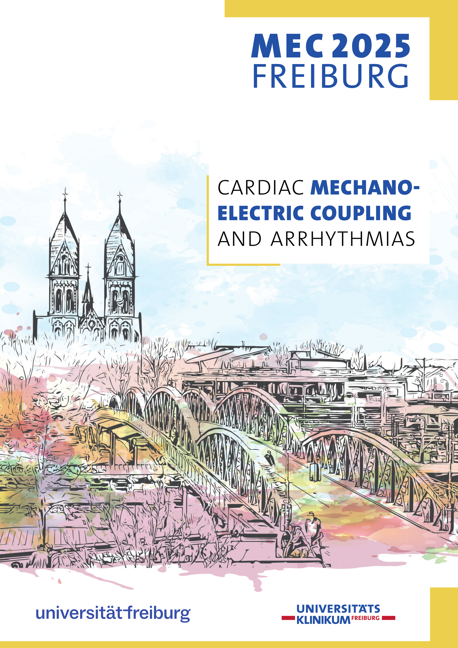
Mechano-Electric Coupling and Arrhythmias 2025
Celebrating the 10th edition of MEC: a brief history….
1994
1997
2002
2007
2010
2013
2016
2019
2022
2025
17 Sept
Arnhem,
Netherlands
02-04 Oct
Trento,
Italy
06-08 Sept
Oxford,
UK
01-04 April
Oxford,
UK
01-04 Sept
Oxford,
UK
12-15 Sept
Oxford,
UK
21-24 Sept
Freiburg,
Germany
04-07 Sept
Freiburg,
Germany
21-24 Sept
Freiburg,
Germany
17-20 Sept
Freiburg,
Germany
Notes:
Done - 1x time-line der 10 meetings
Done - dann für #1Programme
Done - gefolgt von Booklet / Foto / QR to meeting journal issue
Done - danach vielleicht die beiden MEC Bücherausgaben --> die brauchen evtl. ein Update...
Done - dann Bilder vom Konzert?

Slide 3
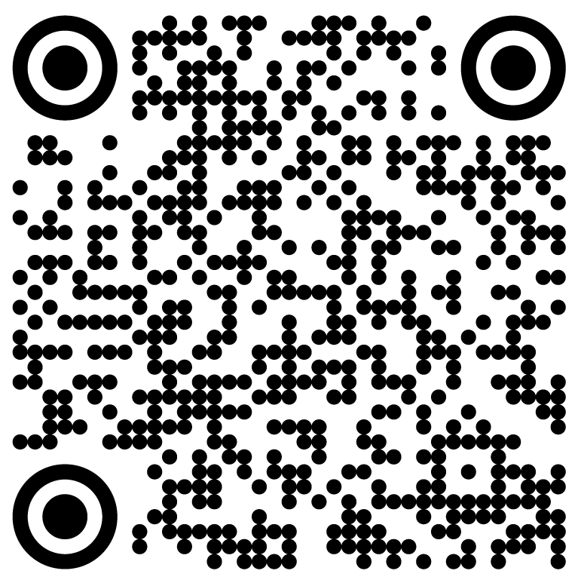
Mechano-Electric Coupling and Arrhythmias 2025
17 Sept 1994 – Arnhem, The Netherlands
Mechanically-Induced Cardiac Activity
1-day workshop
as part of 18th Meeting of EWGCCE
Cardiovasc Res 1996/32(1)

Slide 4
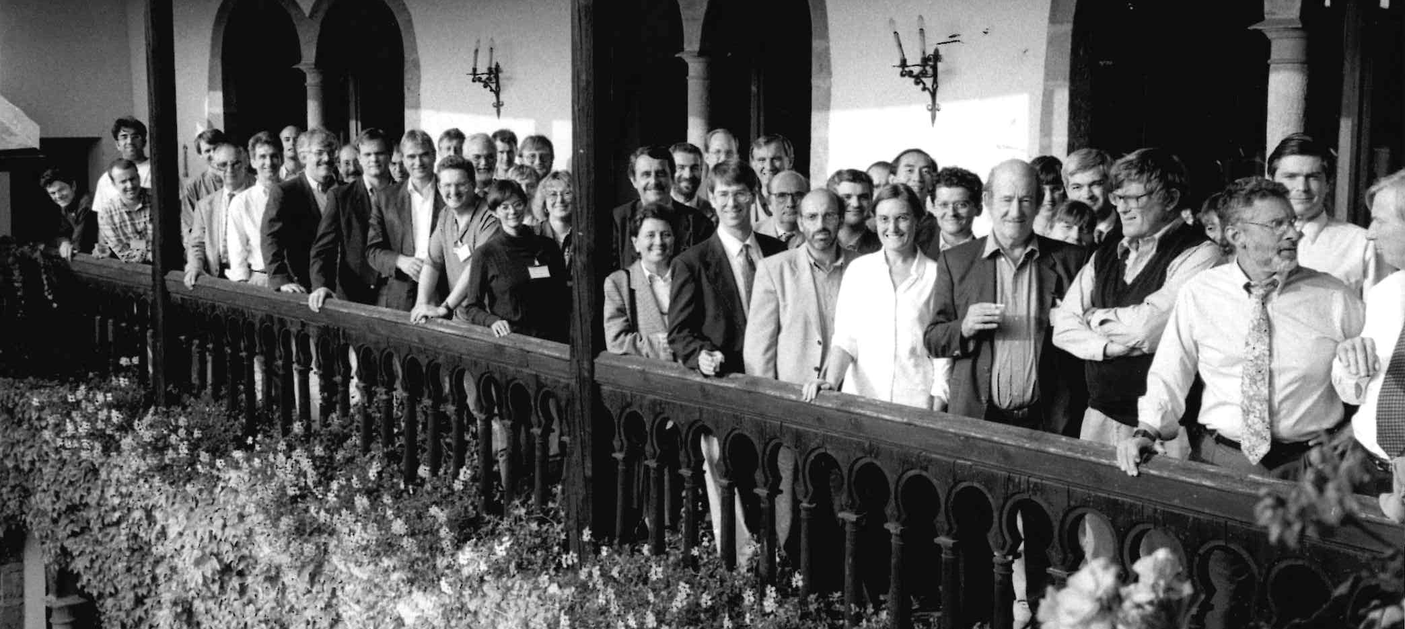
Mechano-Electric Coupling and Arrhythmias 2025
02-04 Oct 1997 – Trento, Italy
Mechano-Electrical Feedback and
Cardiac Arrhythmias

Slide 5
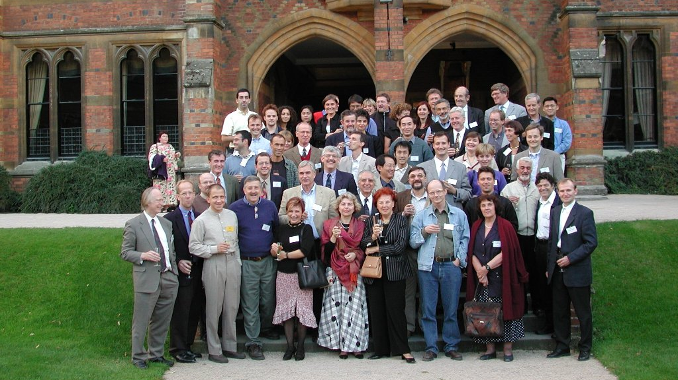
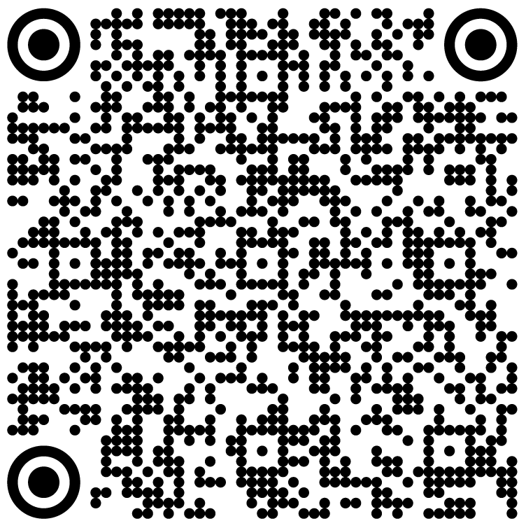
Mechano-Electric Coupling and Arrhythmias 2025
06-08 Sept 2002 – Oxford, UK
3rd Cardiac Mechano-Electric
Feedback and Arrhythmias
Prog Biophys Mol Biol 2003

Slide 6
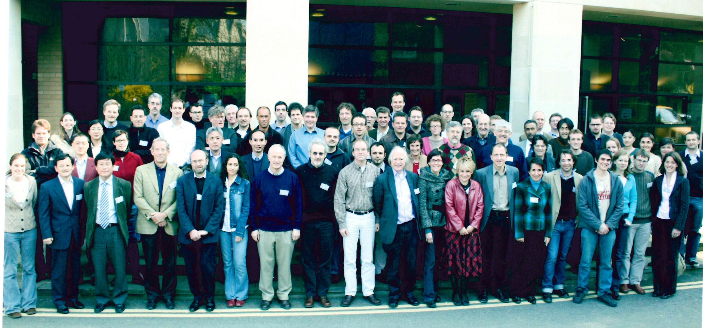
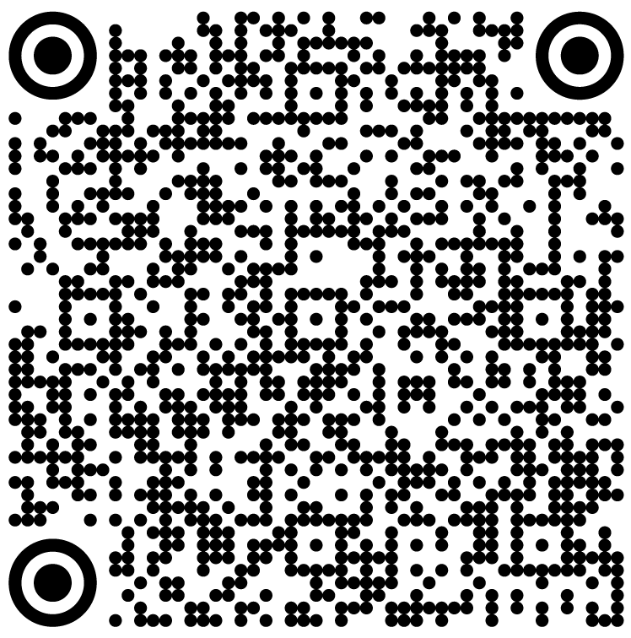
Mechano-Electric Coupling and Arrhythmias 2025
01-04 April 2007 – Oxford, UK
4th Cardiac Mechano-Electric
Feedback and Arrhythmias
Prog Biophys Mol Biol 2008

Slide 7
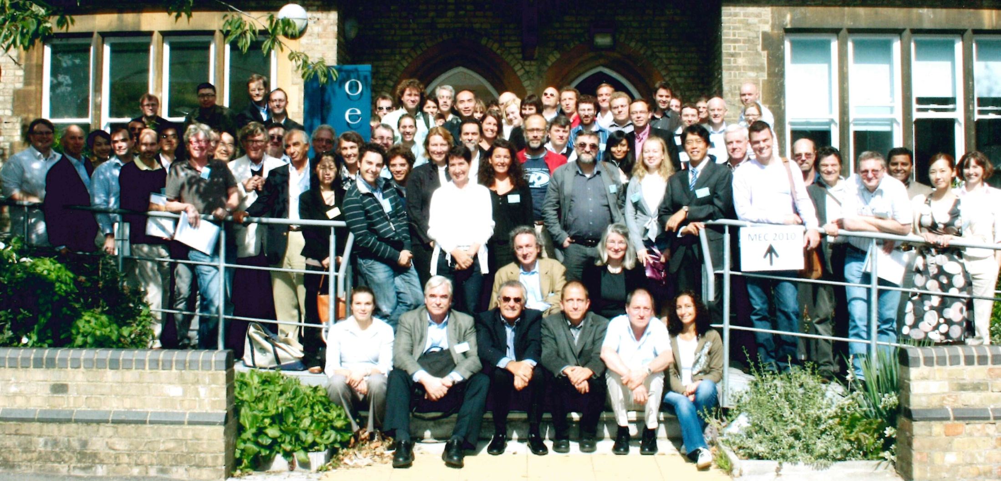
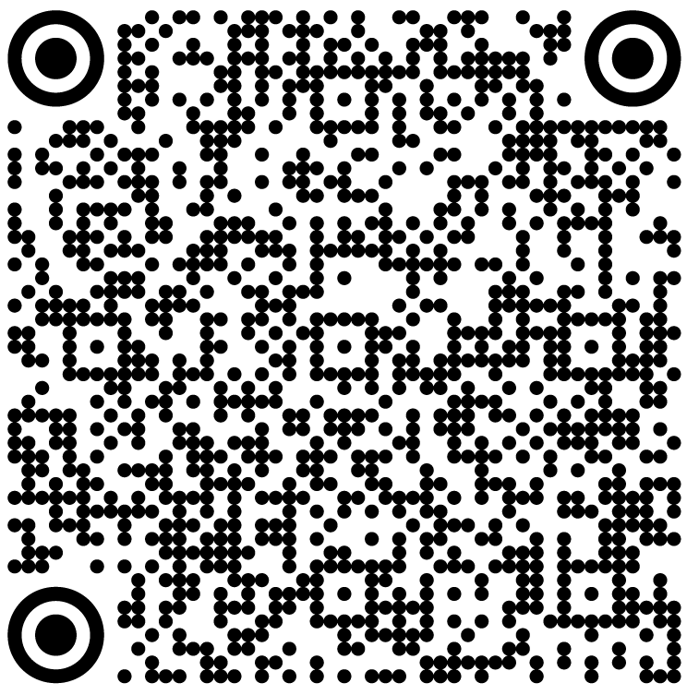
Mechano-Electric Coupling and Arrhythmias 2025
01-04 Sept 2010 – Oxford, UK
5th Cardiac Mechano-Electric
Coupling and Arrhythmias
Prog Biophys Mol Biol 2012

Slide 8
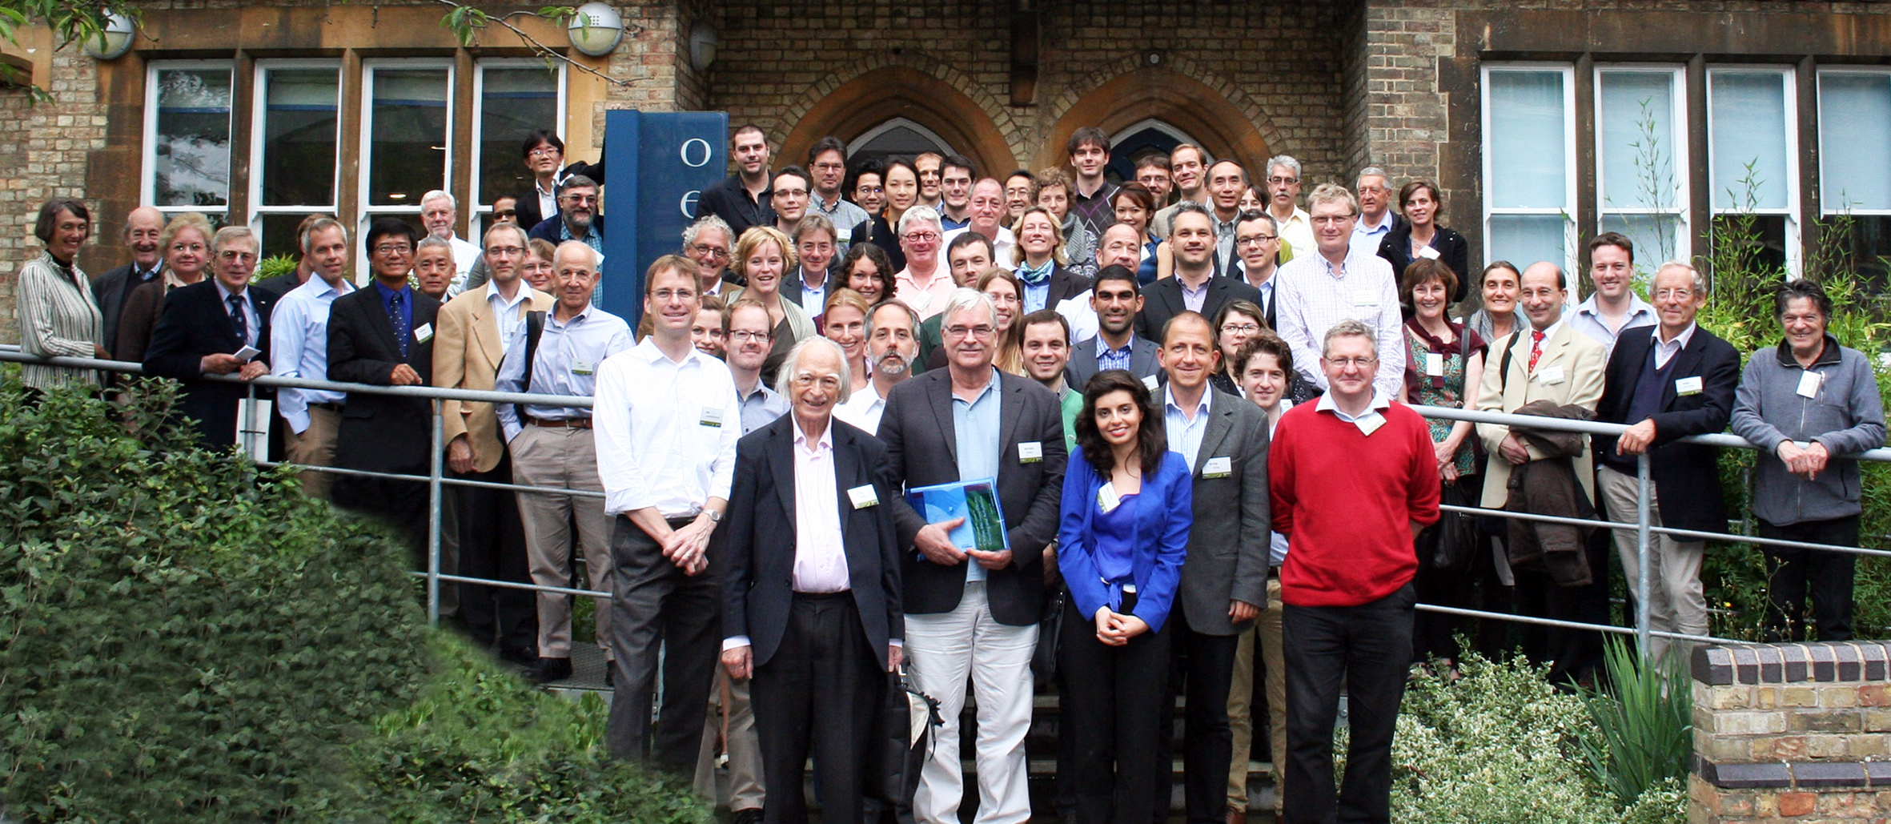
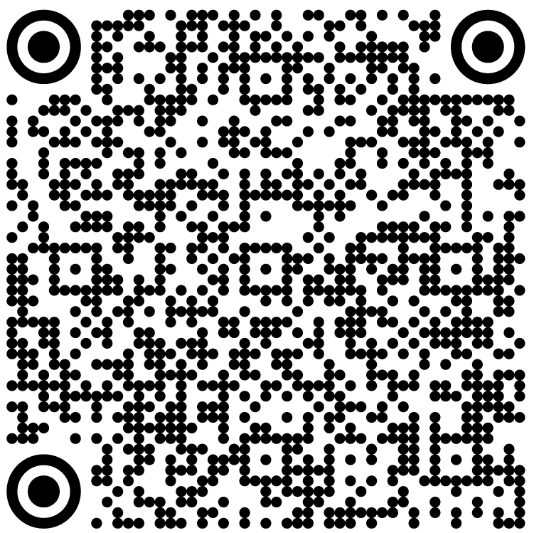
Mechano-Electric Coupling and Arrhythmias 2025
12-15 Sept 2013 – Oxford, UK
6th Cardiac Mechano-Electric
Feedback and Arrhythmias
Prog Biophys Mol Biol 2014

Slide 9
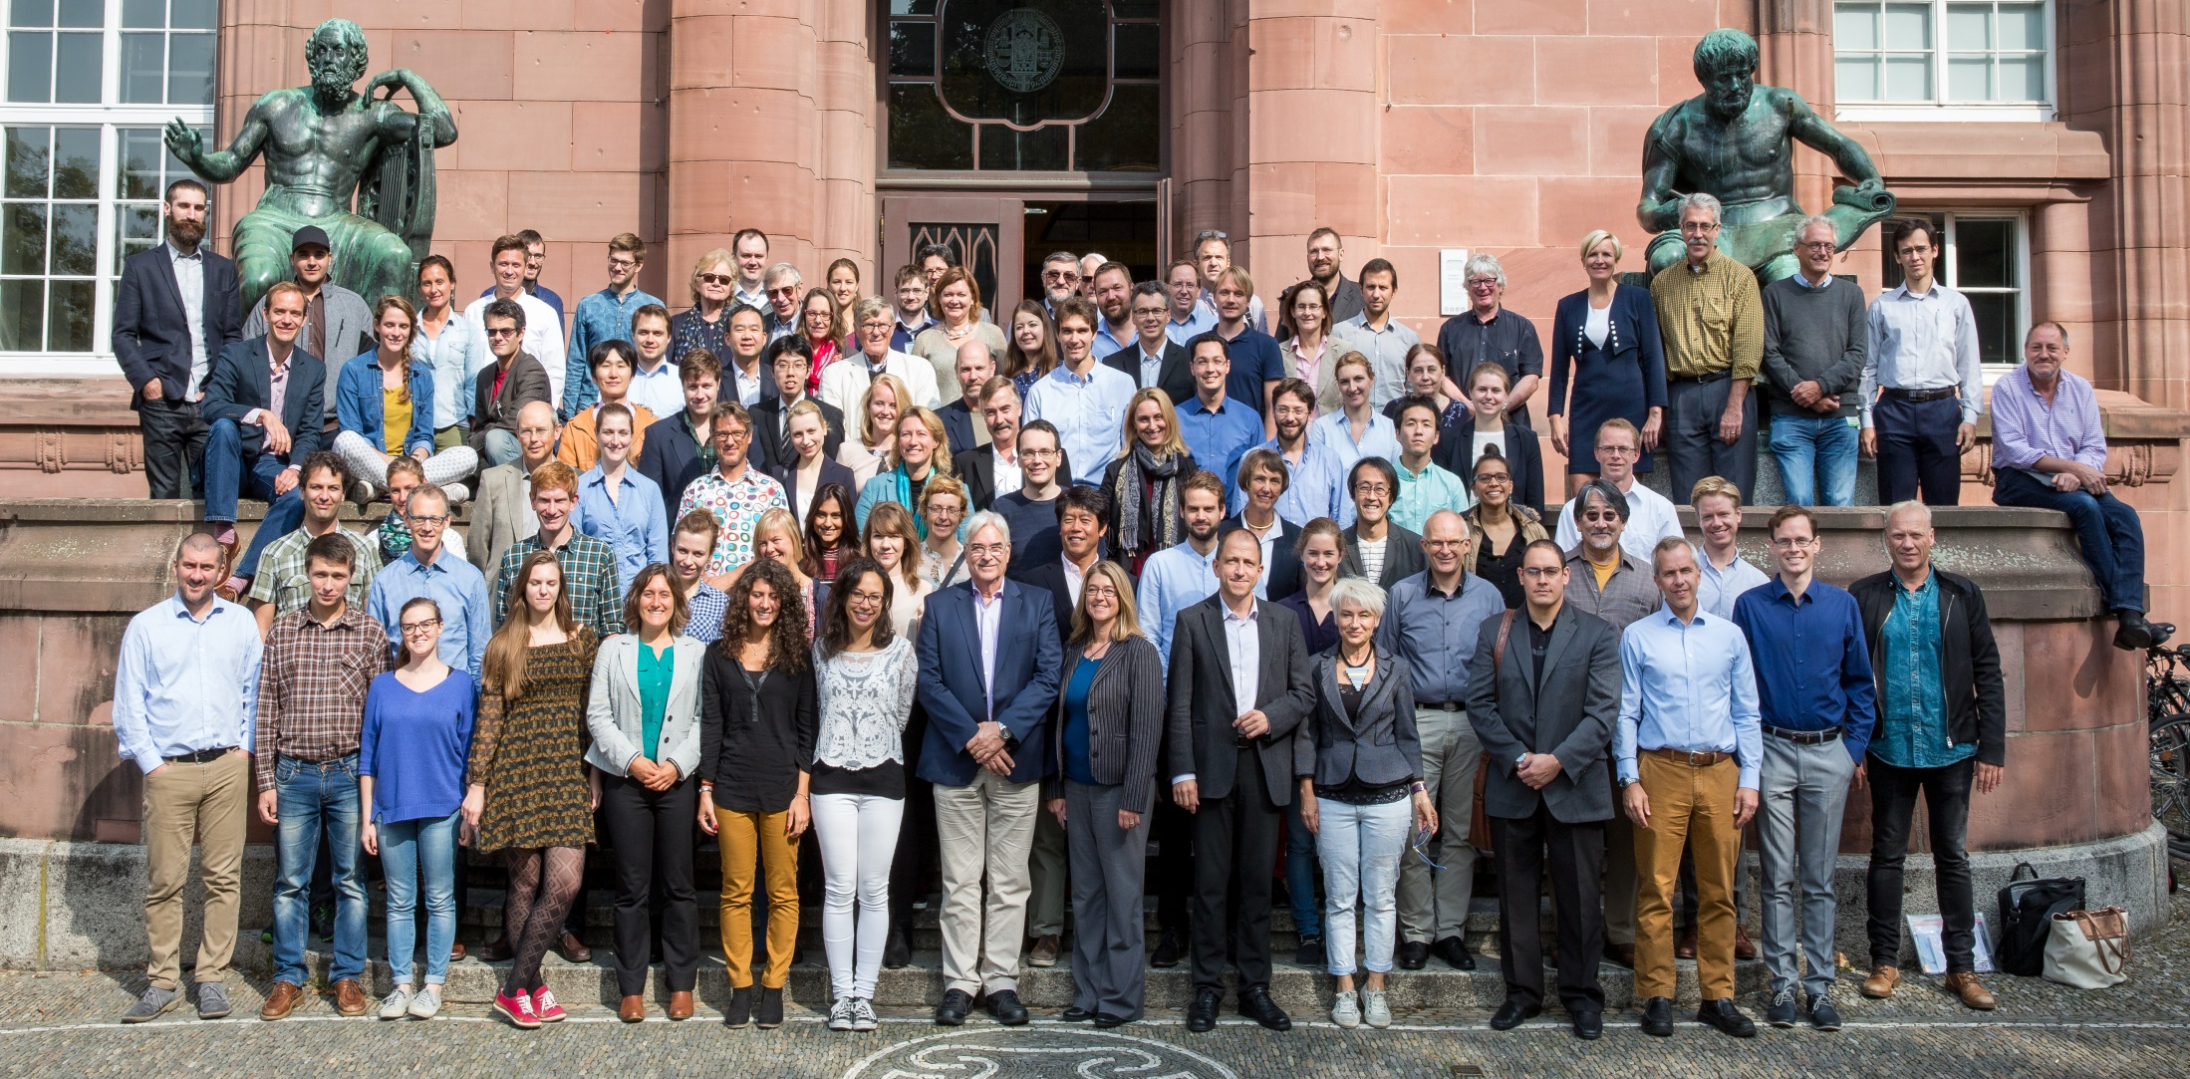
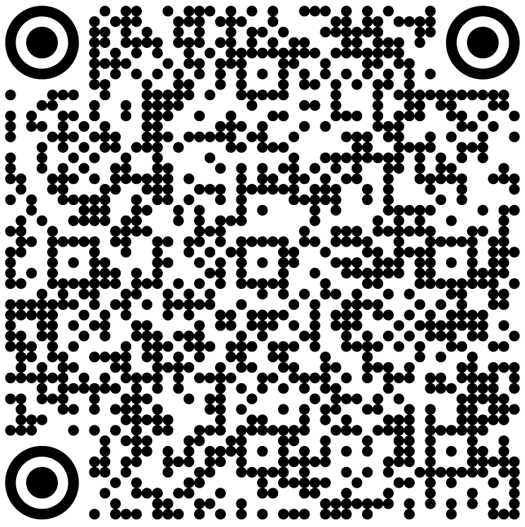
Mechano-Electric Coupling and Arrhythmias 2025
21-24 Sept 2016 – Freiburg, Germany
7th Cardiac Mechano-Electric
Feedback and Arrhythmias
Prog Biophys Mol Biol 2017

Slide 10
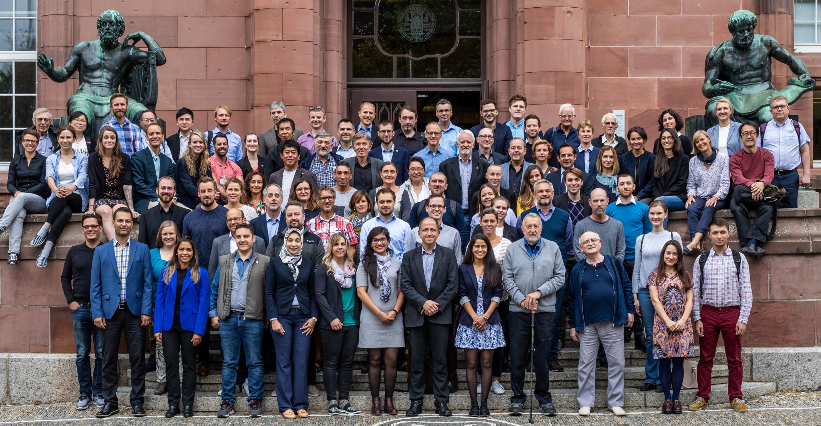
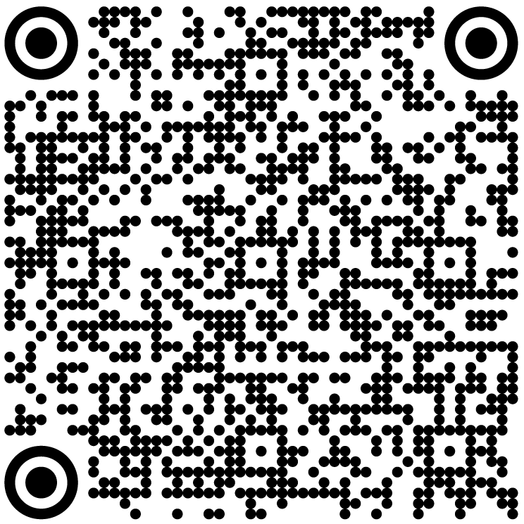
Mechano-Electric Coupling and Arrhythmias 2025
04-07 Sept 2019 – Freiburg, Germany
8th Cardiac Mechano-Electric
Feedback and Arrhythmias
Prog Biophys Mol Biol 2021

Slide 11
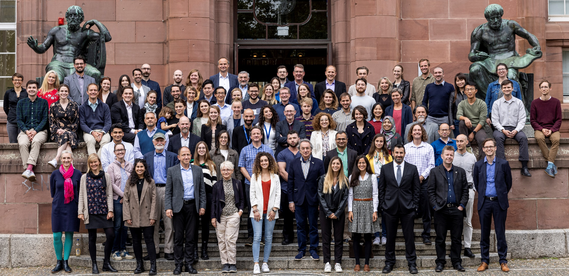
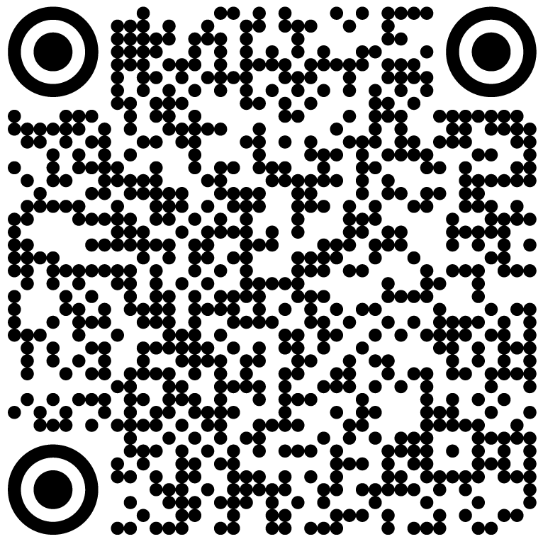
Mechano-Electric Coupling and Arrhythmias 2025
21-24 Sept 2022 – Freiburg, Germany
9th Cardiac Mechano-Electric
Feedback and Arrhythmias
J Physiol 2024/602(18)

Slide 12
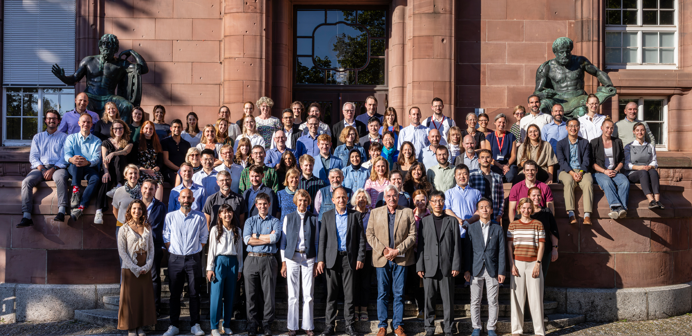
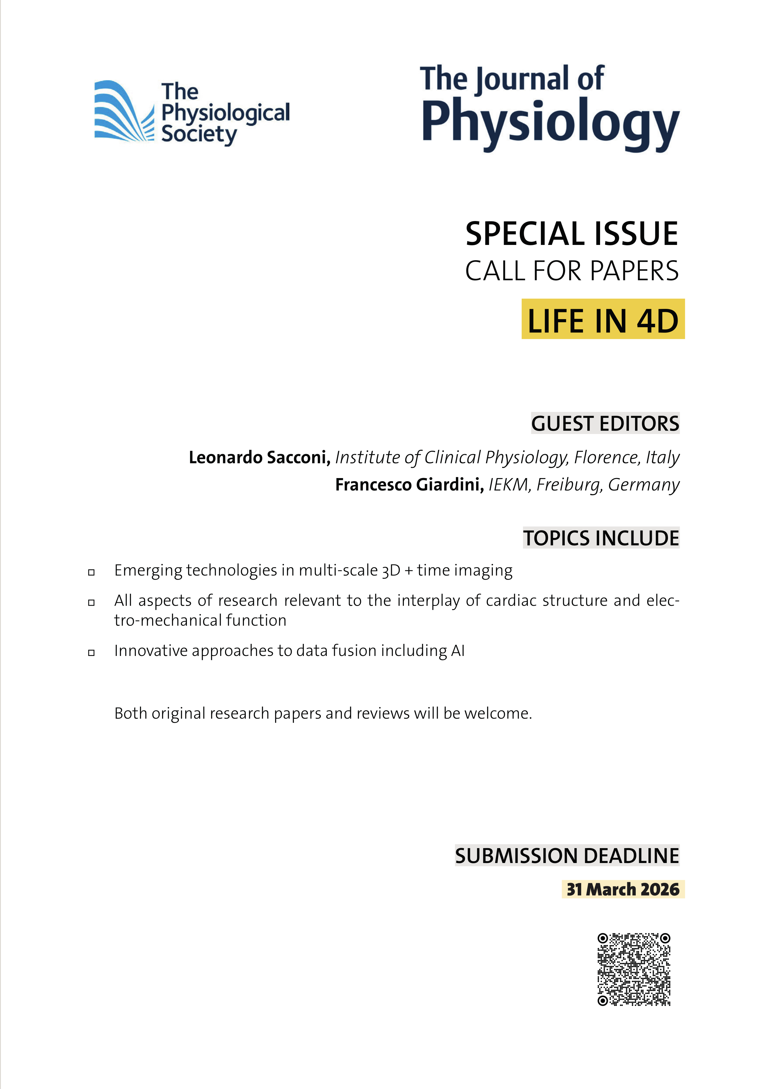
Mechano-Electric Coupling and Arrhythmias 2025
17-20 Sept 2025 – Freiburg, Germany
10th Cardiac Mechano-Electric
Feedback and Arrhythmias

